Slide 1
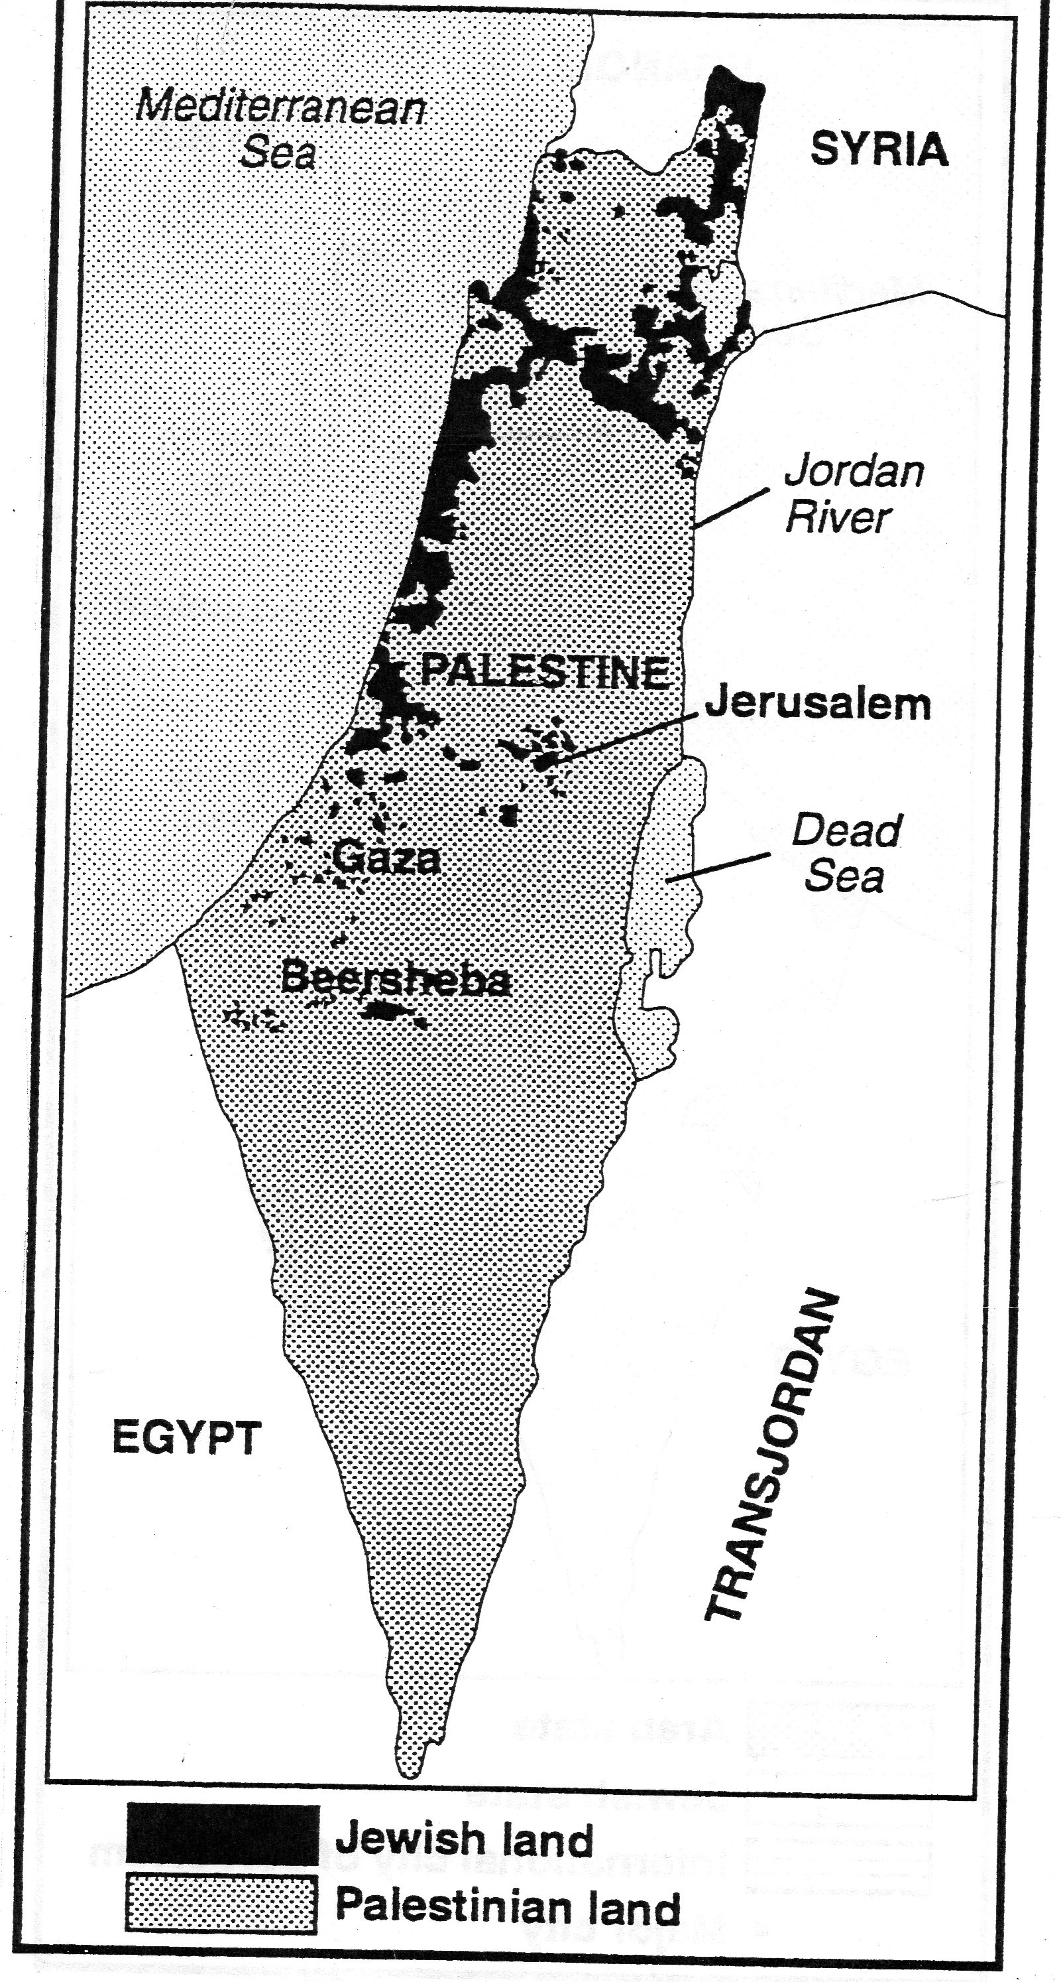
Palestine- British mandate
Palestinian Arabs 90% of
Population
Balfour Declaration:
encouraged
Jewish immigration
(supported by Zionists)
By 1947 fighting escalated
and British turn mandate
over to the United Nations

Slide 2
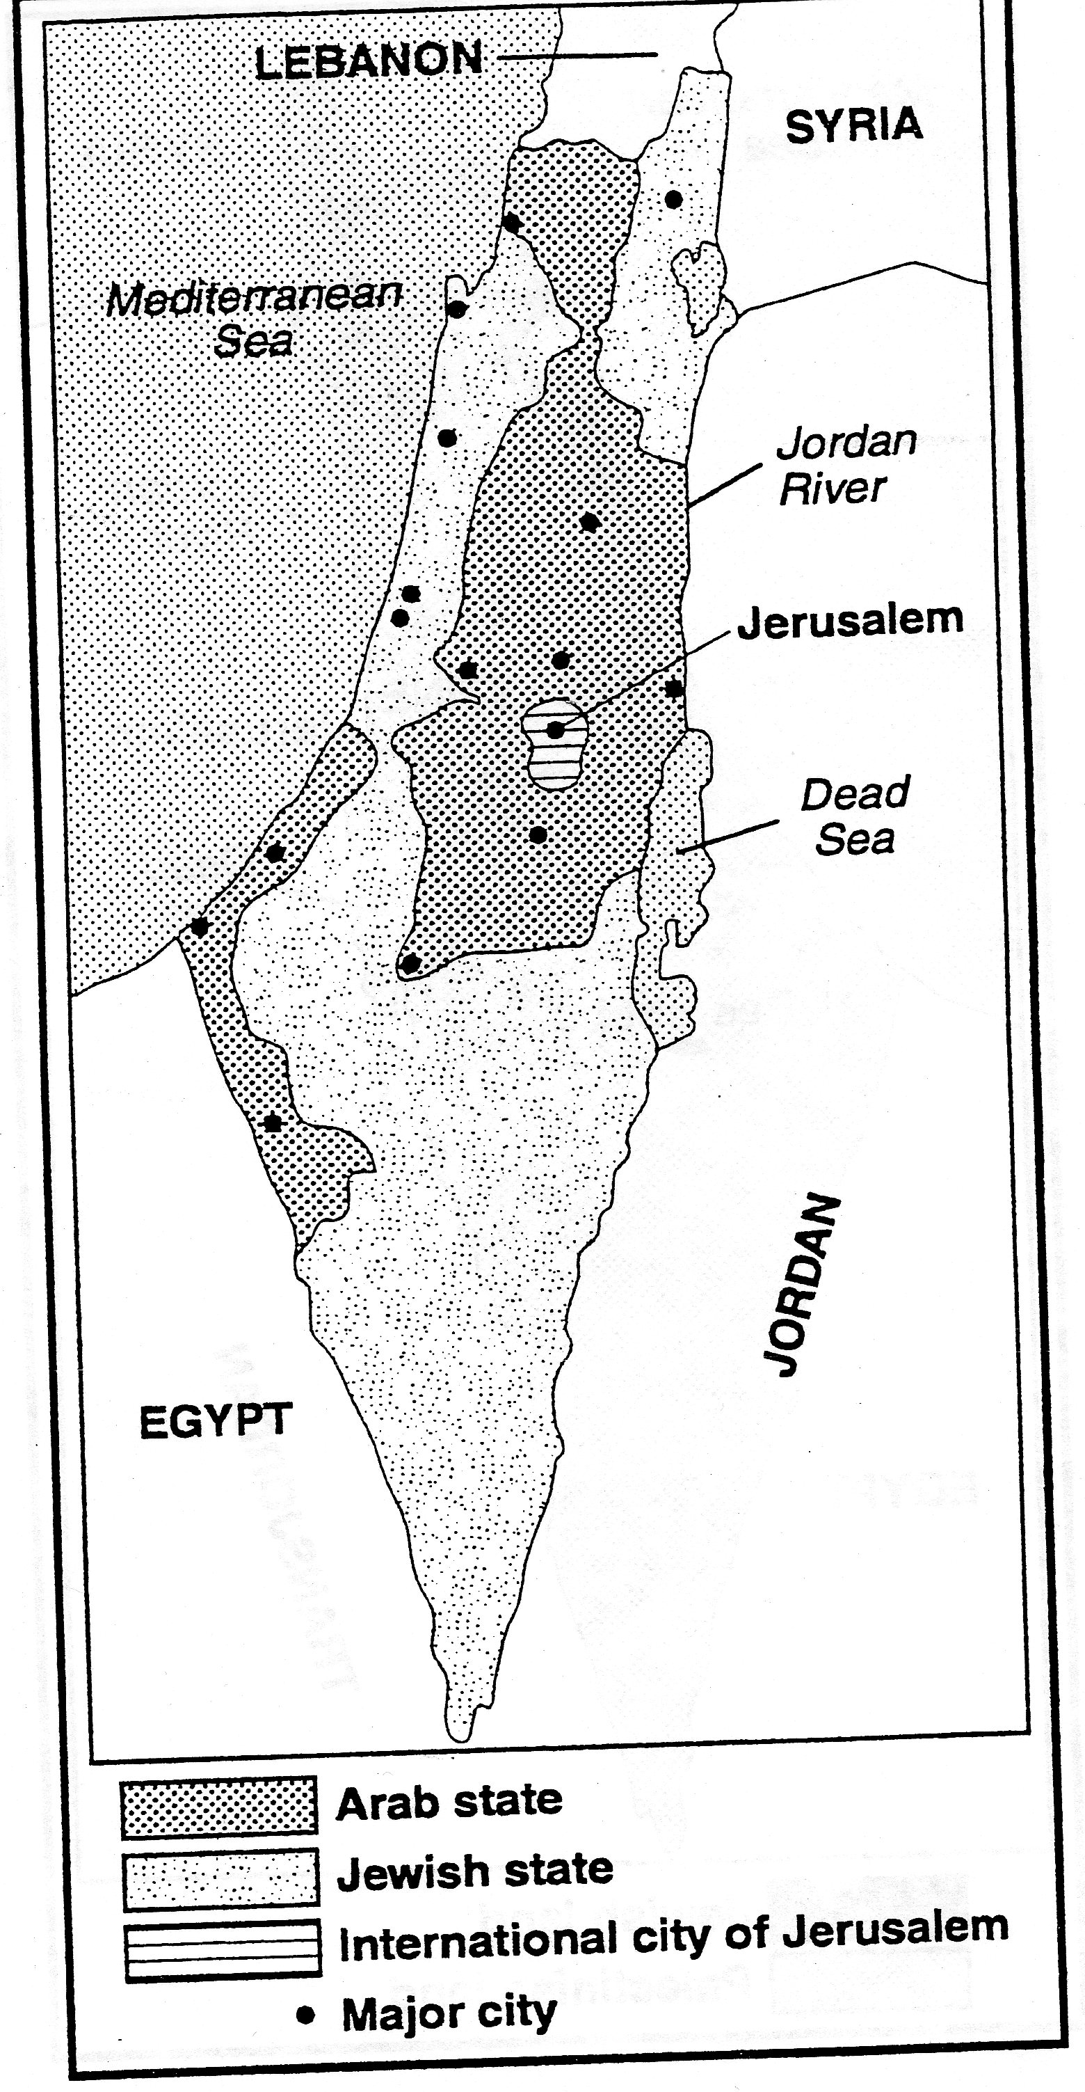
United Nations
Partition Plan –
Was it fair? Justify
your answer.
Write a quick
response below:

Slide 3
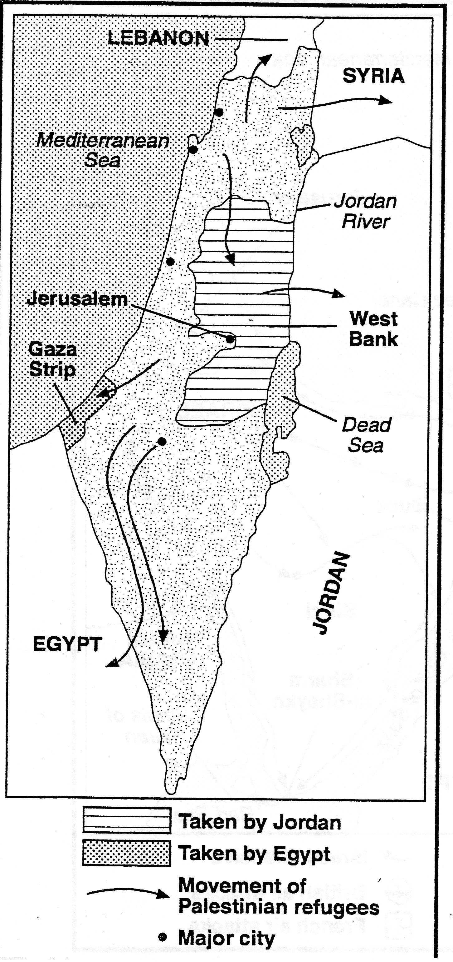
The 1948 War
Independence of the
State of Israel declared
The NEXT DAY Arab
troops from Jordan,
Iraq, Syria, Lebanon, Egypt
And Saudi Arabia invaded
Palestine
By end of 1948 Israel
captured most of the land
Creation of over 700,000
Palestinian refugees

Slide 4
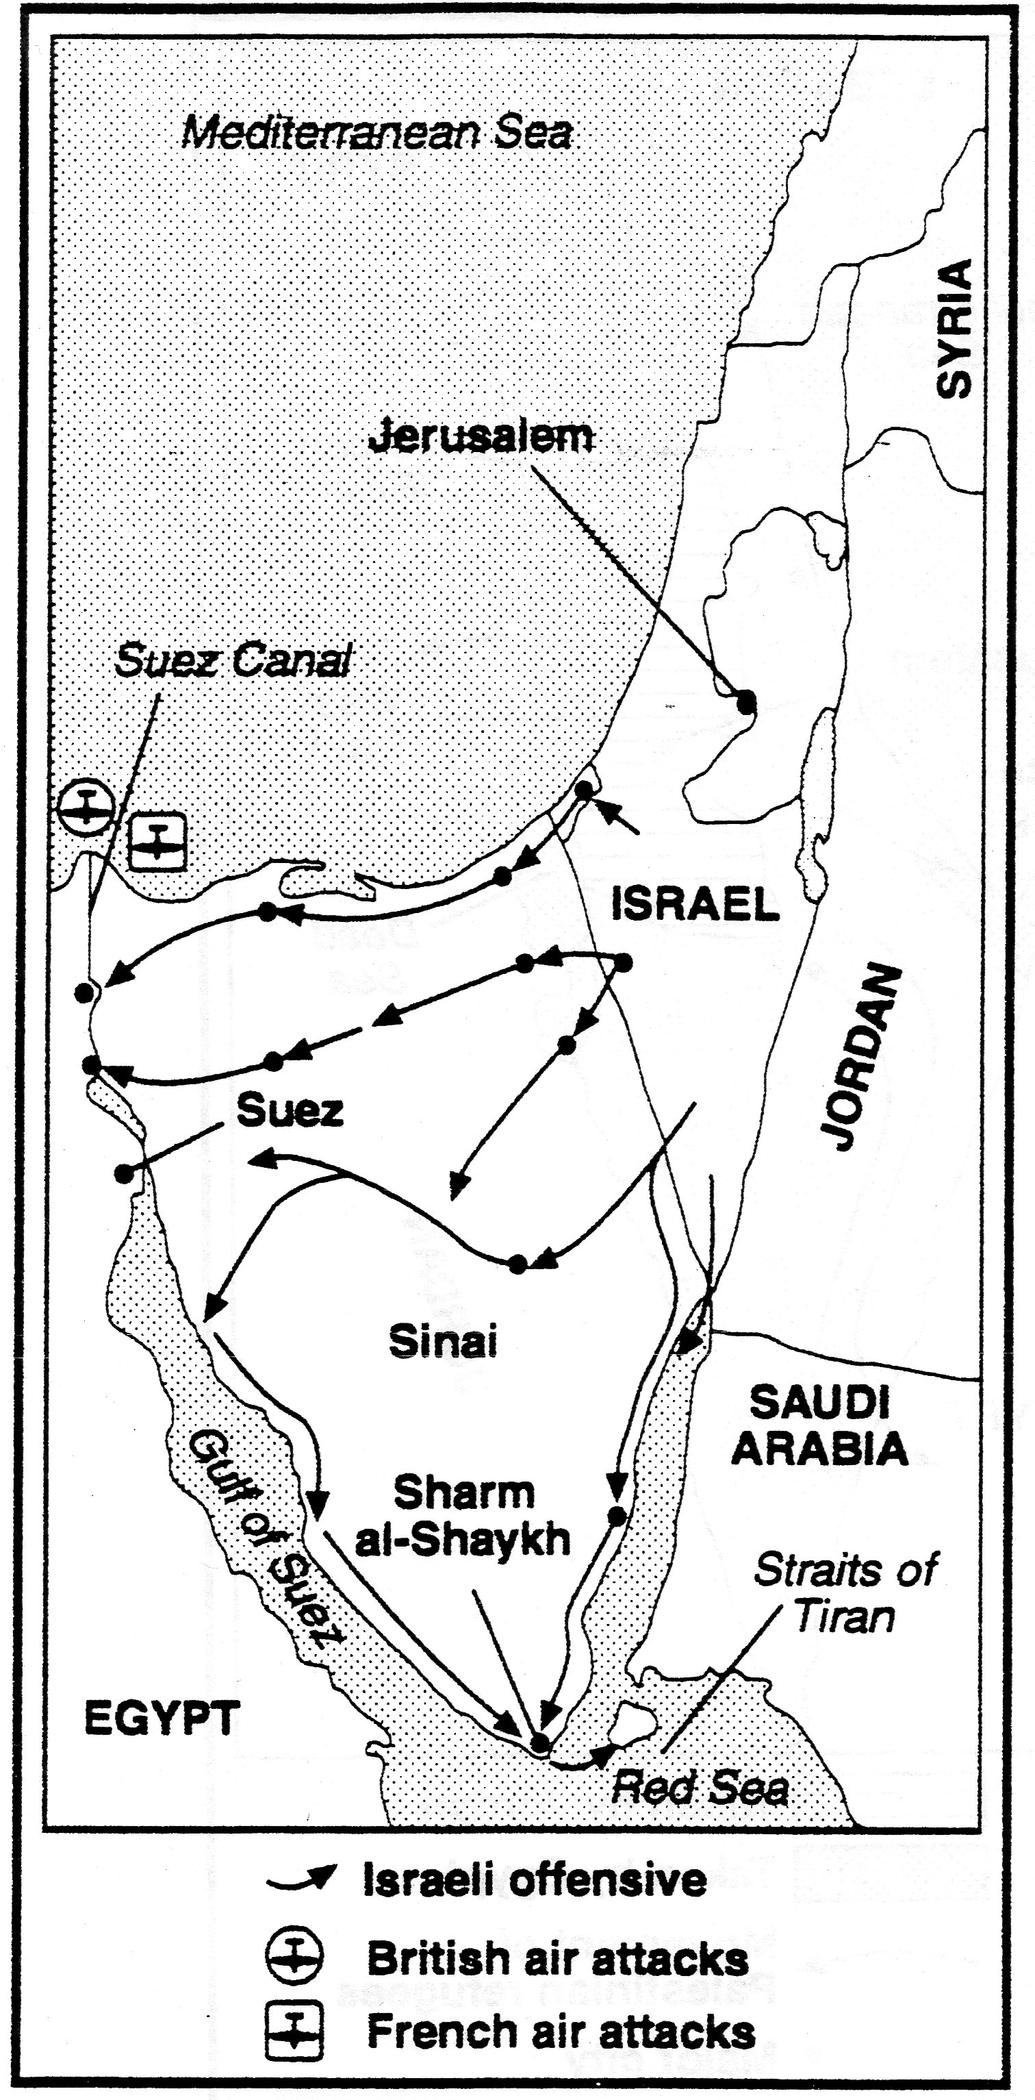
The Suez Canal Crisis
1956 Egyptian leader
Gamal Abdel Nasser tried
to take control of Suez
Canal
Britain and France were
mad and Israel decided
to join them to force
Nasser to give it back.

Slide 5
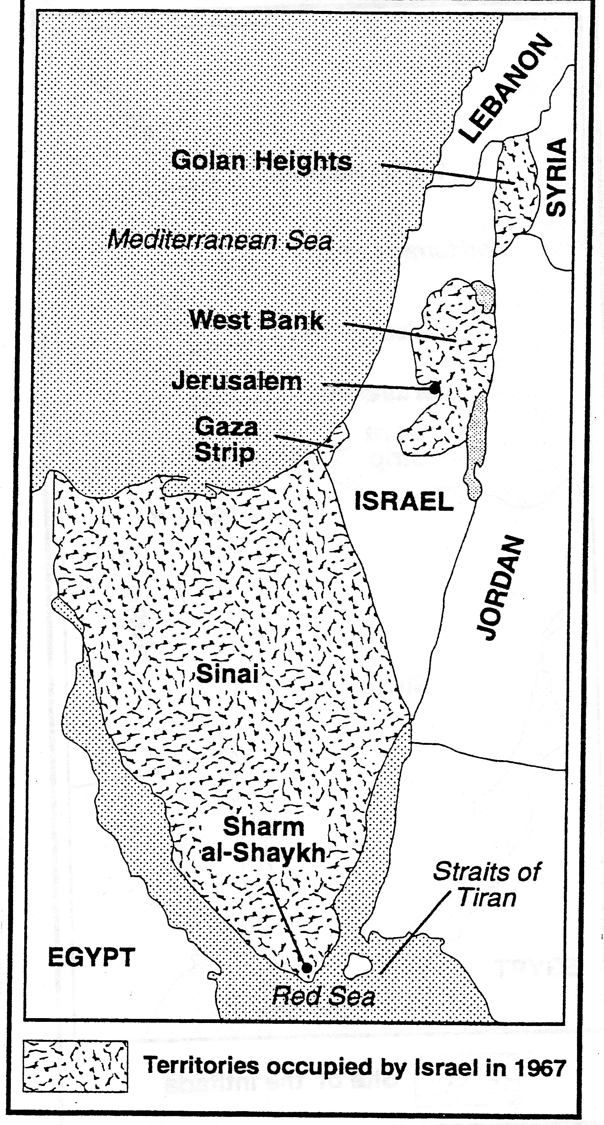
The 1967 War
Nasser continued to cause
trouble
Israel had also suffered
increasing terrorist attacks by
Palestinian groups in Syrian
and Jordanian territories
Israel felt itself surrounded
by hostile forces
1967 launched surprise
attack and capturing Gaza,
Sinai, Golan Heights and
West Bank

Slide 6
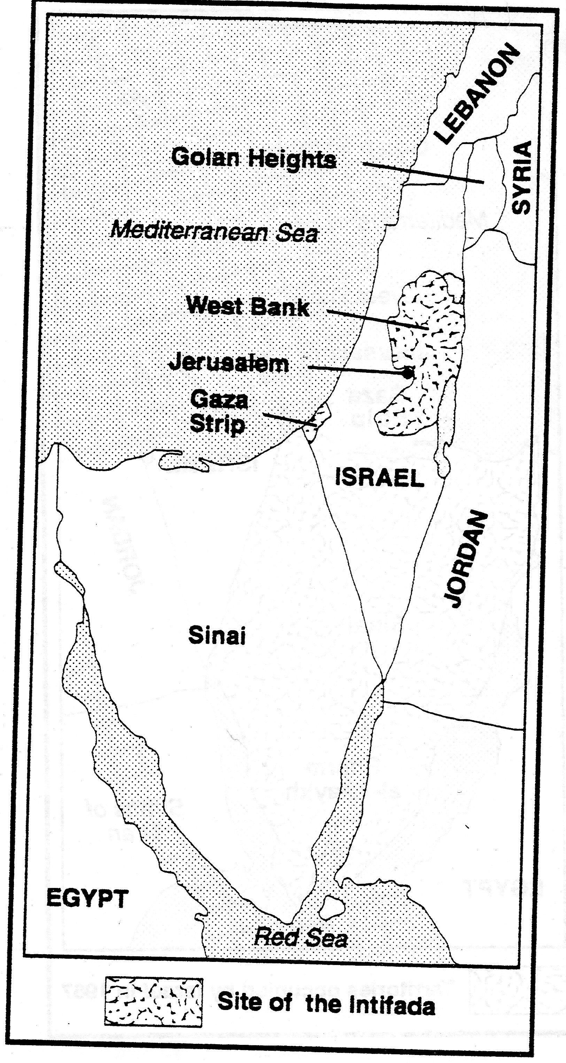
Intifada
Means “shaking off”
in Arabic

