Slide 1
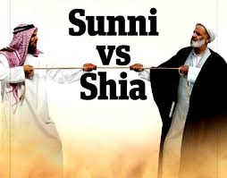
Arab Spring and Current Conflict in the Middle East
What is the difference between the Sunnis and Shi’ites?
The Sunni and Shiite division
dates back to the year 623
The two sects of Islam formed
in the wake of Mohammed’s death
They disagreed over his political successor
Shiites maintain it must be a blood relative
of Mohammed
Sunnis call for a pious individual committed to Mohammed’s teachings to lead
An offshoot of Shiism – Alawites – believed leadership could
come from Mohammed’s son-in-law

Slide 3
ISIL/Islamic State
The Islamic State (sometimes referred to as ISIS) is a Sunni jihadist group
It branched off from Al-Qaeda in Iraq in early 2013
Goal: to create an Islamic state (Caliphate) that straddles Iraq and Syria
ISIL has capitalized on the unrest in both countries by joining the Sunni rebels fighting against President Bashar al-Assad’s Syrian government and bringing violence across the border into Iraq where Shiites dominate state politics.

Slide 4
Arab Spring
In 2011 popular unrest swept across the Middle East
Frustration with corruption and dictatorial governments
High unemployment
Many nations launched pro-democracy movements
OUTCOMES:
*some governments suppressed the protests (Syria)
*others had elections (Egypt) but struggled with stability
*religion also played a role- some wanting to return to traditional religious rule where others wanted to establish secular governments.

Slide 5
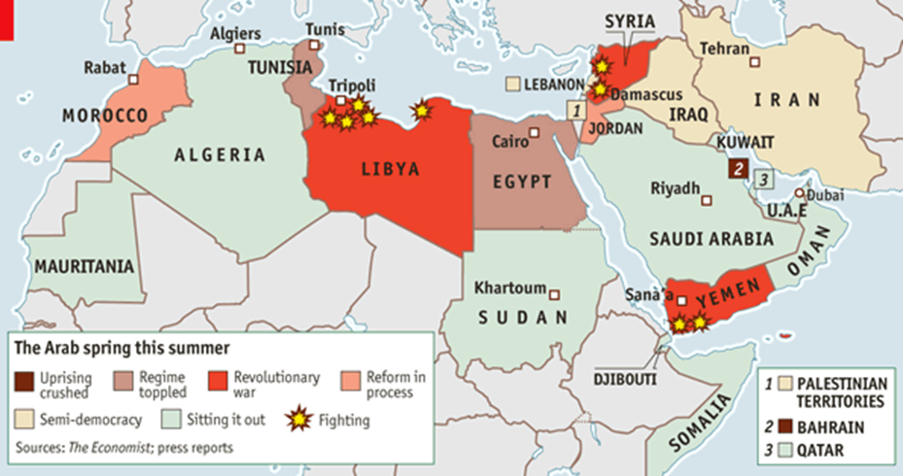

Slide 6
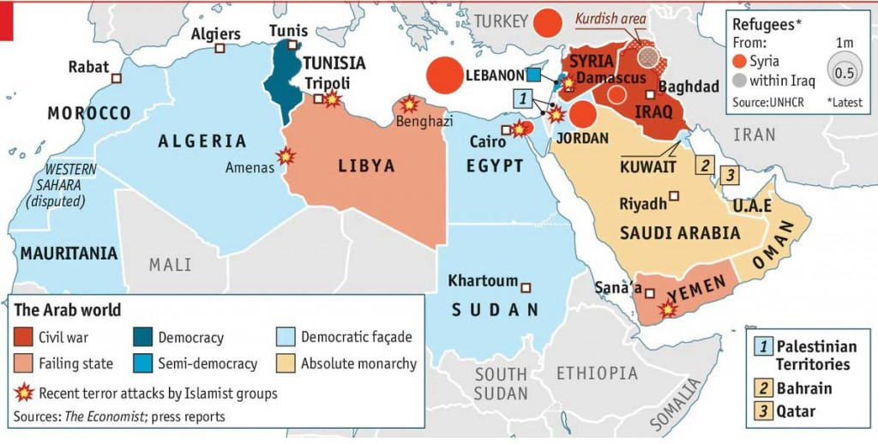

Slide 7
Crisis in Syria – Left side
Create the following outline using the whole left side…..
Introduction
Firing on Civilians
Impact on Iran
Who is..
Bashar Al-Assad
The Alawites
Sunni Muslims
Christians
Free Syrian Army

Slide 8
Crisis in Syria Current Event – right side- double points (10 points)
Website/url
Summary of Event: MUST include
Who
What
When
Where
Why
3. How does the article show the continued crisis in Syria? What do you think will happen next? Why?

