Slide 1
Constitution of 1791
Declaration of the Rights of Man and Citizen
Enlightenment Influence

Slide 2
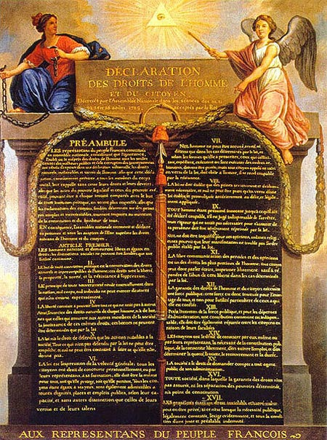
Declaration of the Rights of Man and Citizen – underline and label the following influences in the document:
Locke
Montesquieu
Rousseau
Wollstonecraft

Slide 3
Enlightenment Influence
The Declaration of the Rights of Man was influenced by the Enlightenment. Locke’s ideas are in the document when it says, “ . . .” Another Enlightenment idea in the document is “ . . .” A final idea comes from, “….”. In conclusion, the Enlightenment had enormous influence on the Declaration of the Rights of Man.

