Slide 1
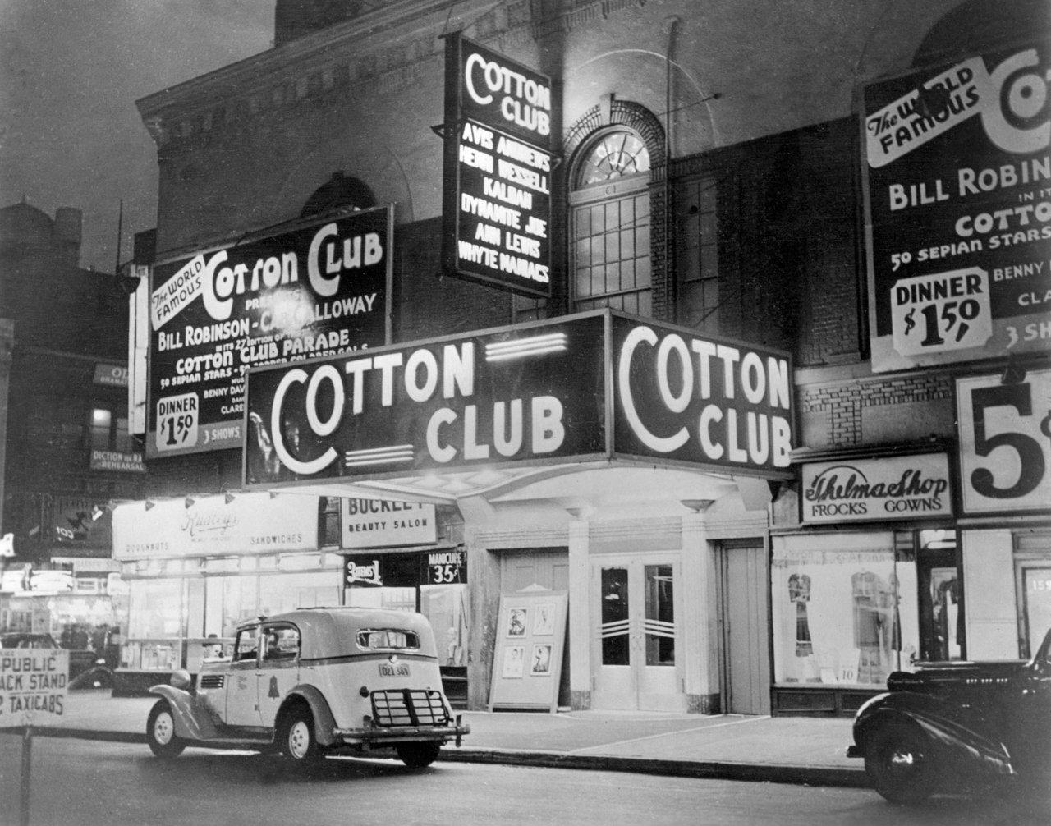
Harlem Renaissance
Chapter 12.8 pgs 508-510 Cornell Notes (right side)
Harlem Renaissance Reading & Questions (HW Lottery Assignment)

Slide 2
HW Lottery Assignment
Using your homework, answer the following question
Describe the lasting impact of the Harlem Renaissance on African American culture in America.

Slide 3
HW Lottery Assignment- Continued
Reading - “Let America be America Again” by Langston Hughes
Answer the questions:
What does Hughes mean when he says “let America be the dream the dreamers dreamed”?
What groups does Hughes say have found America to be lacking in its promises? Why or how has each group been let down?
In the first stanza of the second column, what does Hughes say is ironic about the fact that America has let him down?
What “must America be” for Hughes?
What has to happen, according to Hughes, for America to change?

Slide 4
HW Lottery Assignment Continued…
Reading - “When the Negro was in Vogue” by Langston Hughes
Answer the questions:
Describe Harlem in the 1920s based on the reading.
Why was white America suddenly so fascinated by Harlem?
What is ironic about the situations Hughes describes?
Overall, why did Hughes find the popularity of the Harlem Renaissance amongst whites frustrating?

