Slide 1
ASIA

Slide 2
Geography
Largest Continent on Earth
From Ural Mts. To Turkey to Japan

Slide 3
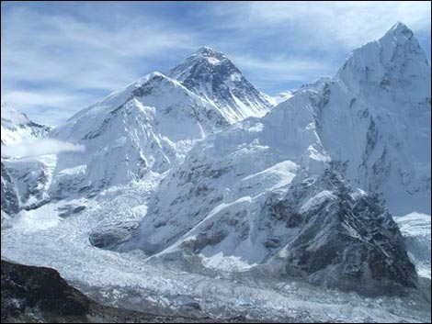
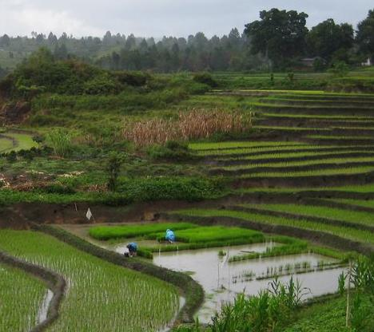
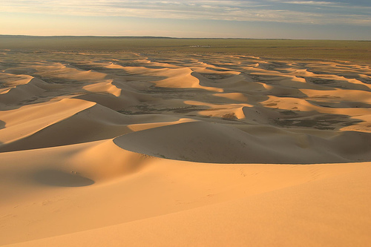

Slide 4
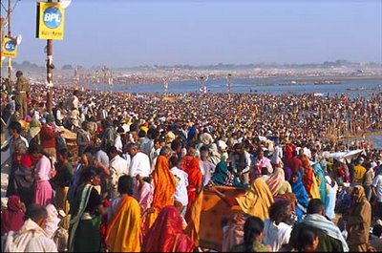
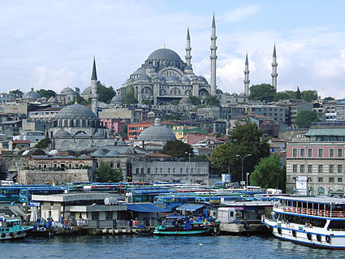
Population
3.879 Billion People

Slide 5
Languages
At Least 26 Languages

Slide 6
Religions
Origin of many major World Religions
Hinduism
Buddhism
Islam
Judaism
Christianity
Taoism
Confucianism
Indigenous Belief Systems

Slide 7
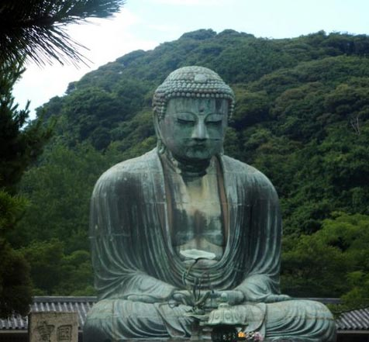
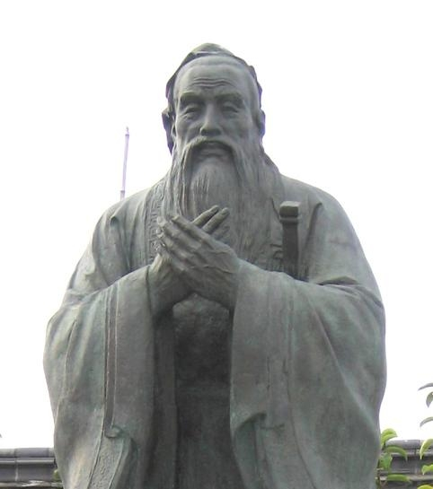
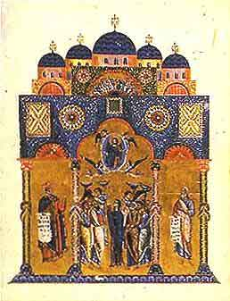
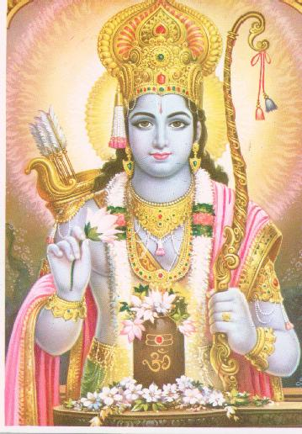
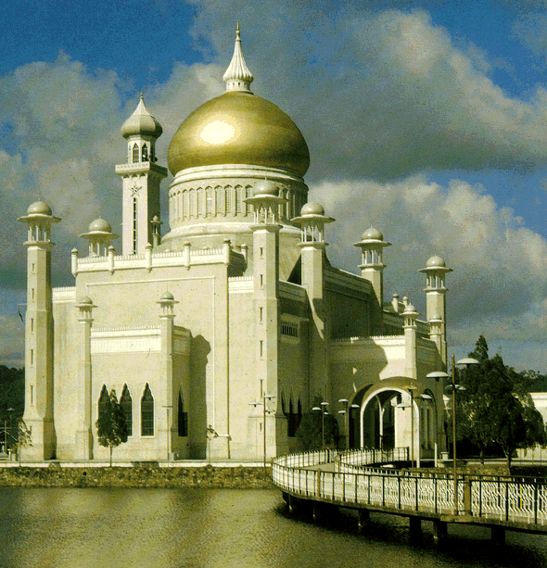

Slide 8
Recapping Asia
Largest Continent
From Ural Mountains to Turkey to Japan
3.879 Billion People in 2006
47 Countries in Asia
At Least 26 Languages Spoken
Home to many major World Religions

