Slide 1
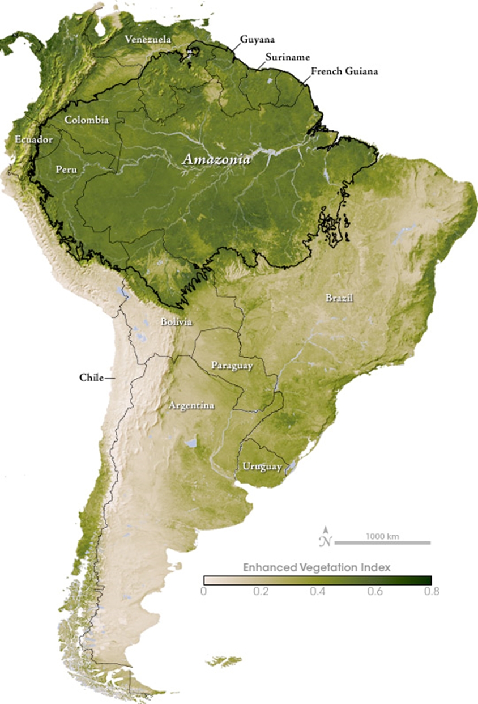

Slide 2
Rainforest Reading Summary – right side
Add 3-4 bullet points per paragraph

Slide 3
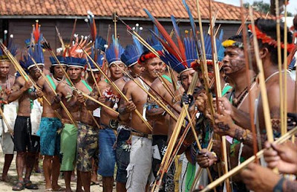
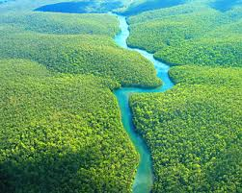
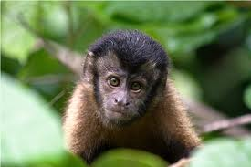
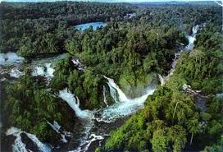

Slide 4
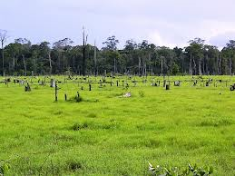
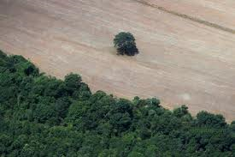
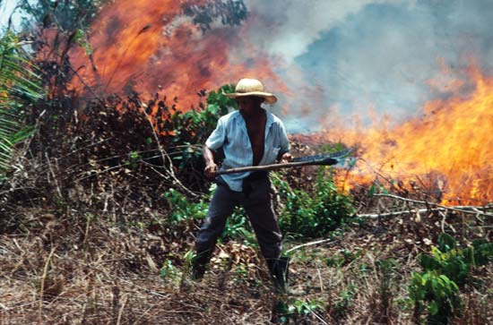
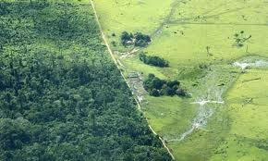

Slide 5
The Flooded Forest – Video Assignment
Directions: As you watch the video, describe AT LEAST 20 things that make the Flooded Forest so unique. This list should include people, animals, plants, discoveries, etc. Be sure to record your information in as much detail as possible.

