Slide 1
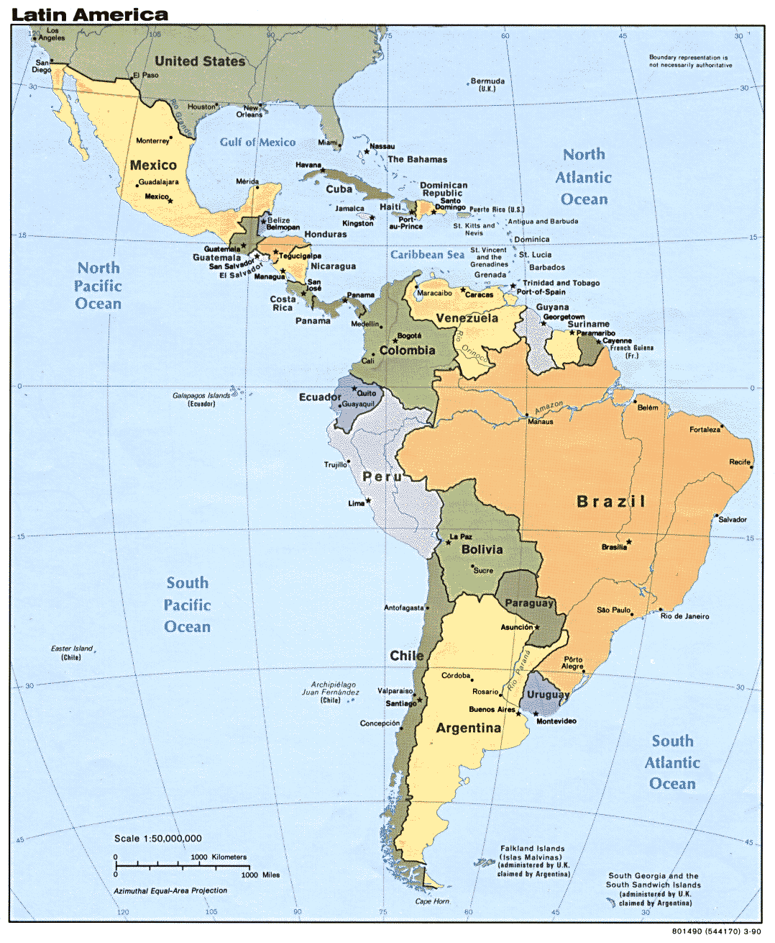
Latin America’s Diversity
I. Key Ethnic Groups
Indian (Mayan, Incan, Aztec)
European (mostly Spanish)
African (slave trade)
Mestizo (mixture of Indian and European)
Mulatto (mixture of African and European
II. Economic Classes
a few wealthy
small middle class
many poor

