Slide 1
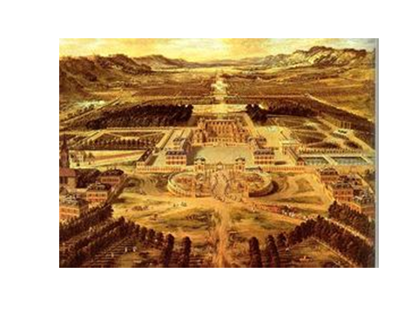
The Palace of Versailles

Slide 2
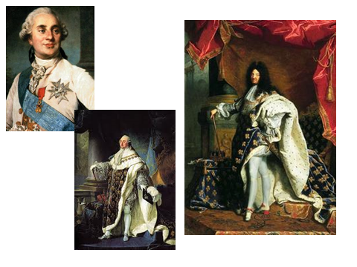
King Louis XVI

Slide 3
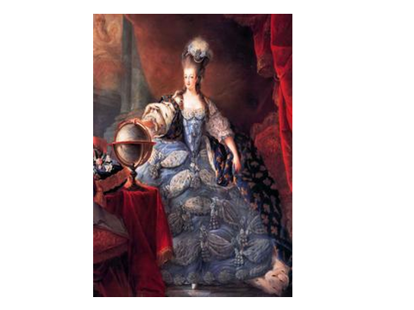
Marie Antoinette

Slide 5
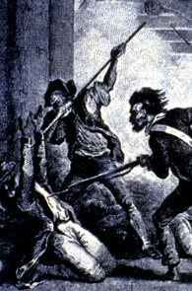
Notebook Entry #1 -The French Revolution – Overview Notes- Right Side

Slide 6
Ancient Regime
French society depended on wheat production and was the basis for taxation and food supply
Nobles and Clergy did NOT pay taxes
This system was in place since the days of the Middle Ages

Slide 8
Long-term Problems of France
France has HUGE debt by late 18th century
Military expenses
Extravagant lifestyle of king and nobles
A sharp rise in taxes – peasants pay most
Poor harvests
Price of bread SOARS!
©1996Instructional Resources Corporation
“King Louis XVI”

Slide 9
The French Revolution – video Clip – Right Side Continued
Record notes (in bullet form) under the following titles:
KINGXVI
MARIE ANTOINETTE
INFLUENCE OF THE ENLIGHTENMENT

