Slide 1
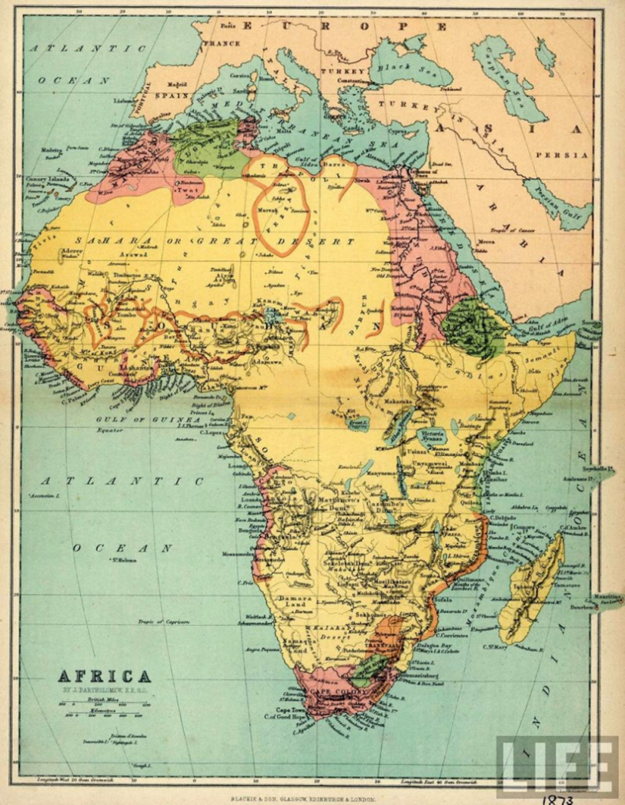
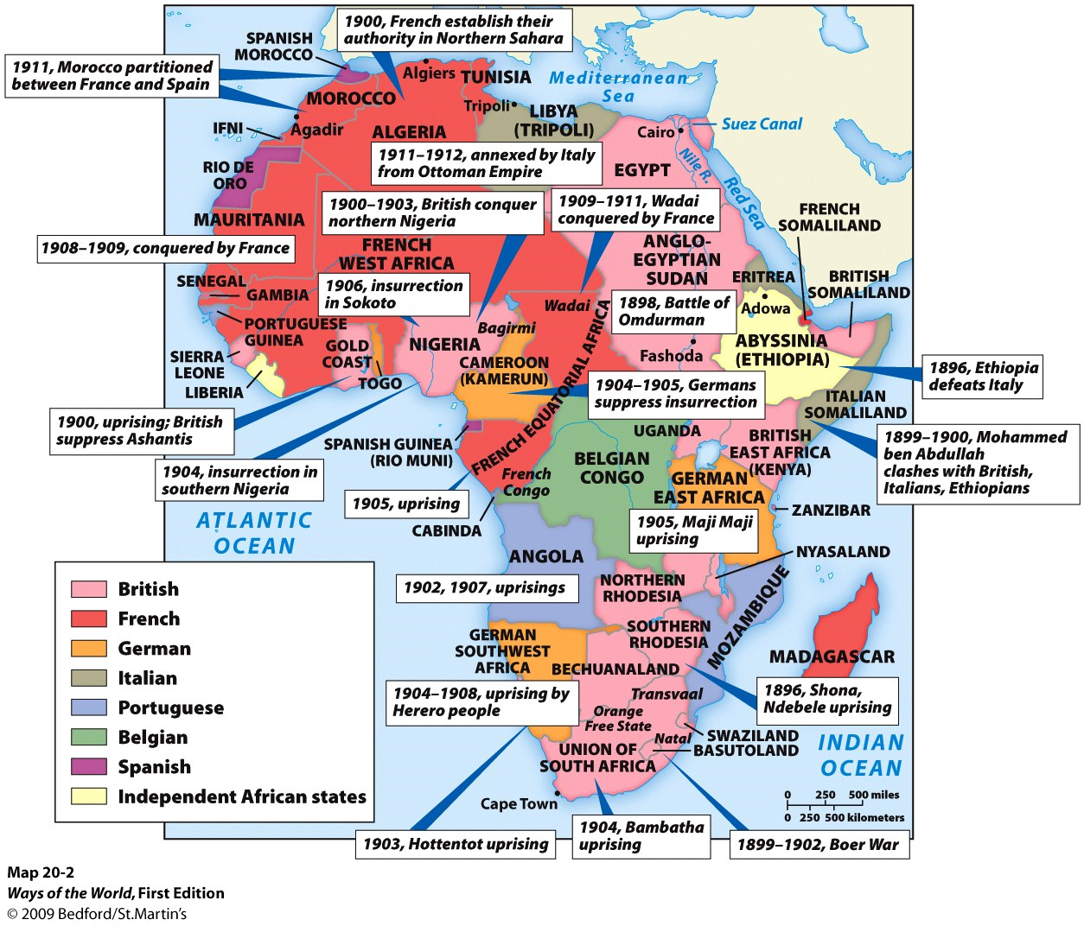

Slide 2
The Eagle and the Chicken – Left Side
Label the following:

Slide 3
Left Side -
Imperialism: When one country dominates another politically, socially and culturally
1. Define each motive and draw a symbol to represent each one!
Political
Economic
Exploratory
Religious
Ideological

Slide 4
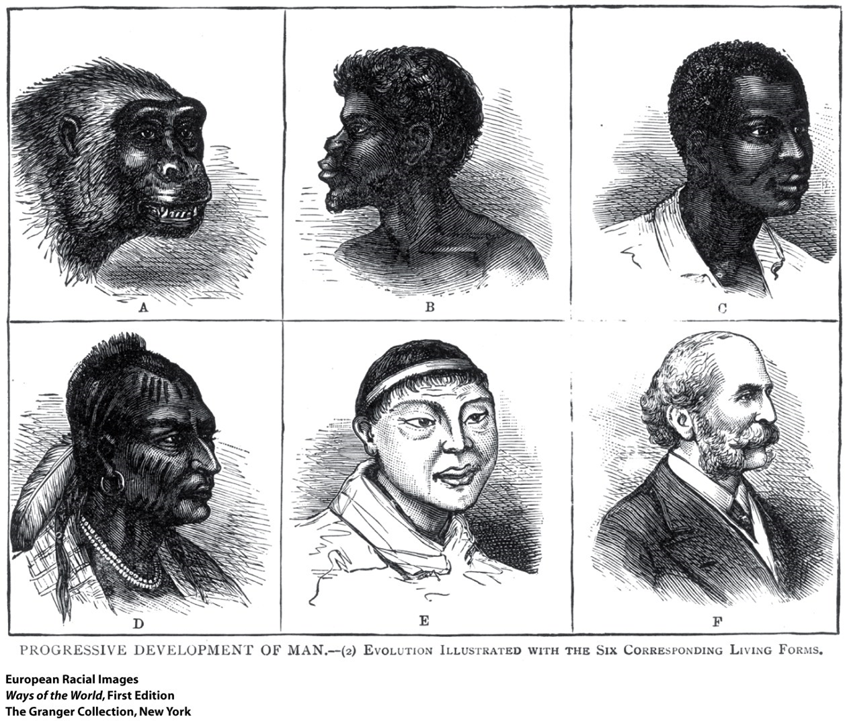

Slide 5
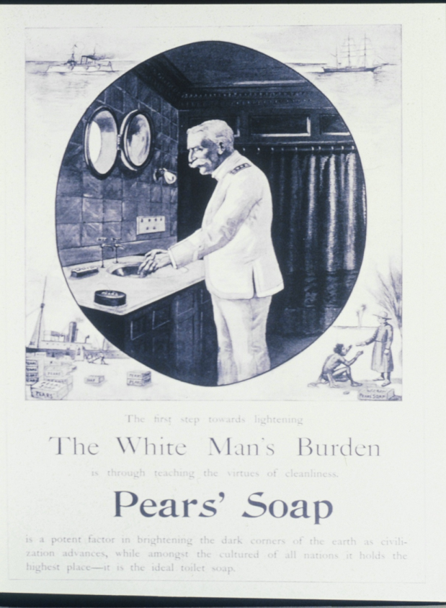
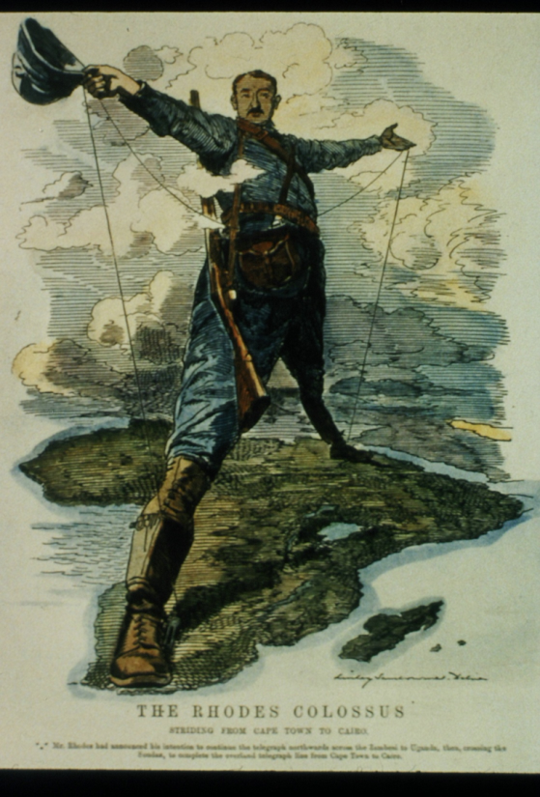
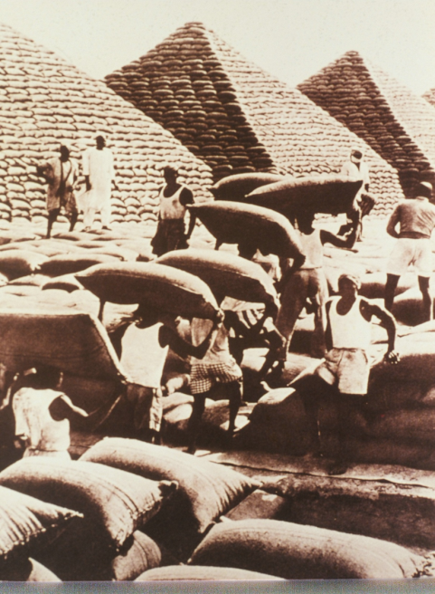
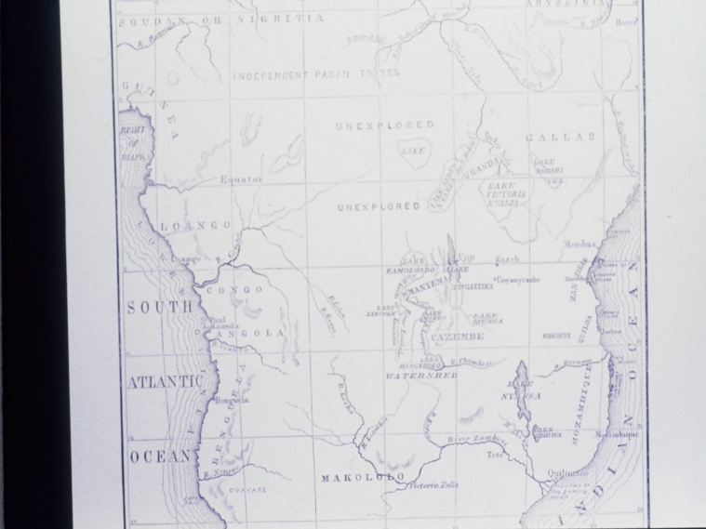
2. Identify the motives for the following:
B.
C.
A.
D.

Slide 6
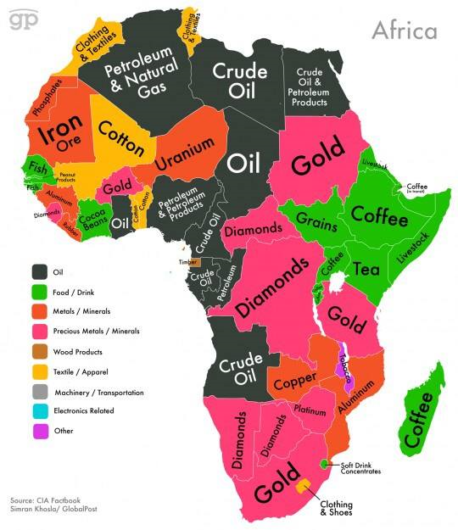

Slide 7
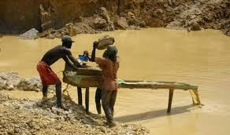
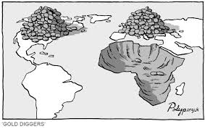
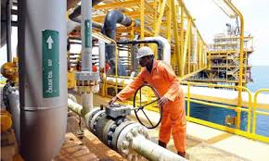
Left side continued…
3. Africa is a continent rich in natural resources. How could this both help or hamper nations seeking to emerge from colonial rule?

Slide 8
Challenges of Becoming Independent Right Side
After WWII more and more African nations began to demand independence (1946-1960).
Some new African nations enjoyed peace and democracy, others plunged into dictatorship, military rule, civil war, and corruption
Dictatorship
democracy
Military coup
Coup d'état = forcible overthrow of government
Civil War
Military rule

Slide 9
