Slide 1
Immigrant Cartoons – Wrap Up Left side
What are the positive attitudes or views toward immigrants depicted in the political cartoons?
What are some negative attitudes or views depicted in them?
What was difficult about analyzing the cartoons?
In what ways do you think American attitudes toward immigrants around the turn of the century are similar to American attitudes today? In what ways are they different?

Slide 2
Left side continued…
Directions:
Create a political cartoon showing either your own attitude OR the attitude you think most people in the US hold toward immigrants today. Write a caption and short explanation of the cartoon at the bottom.

Slide 3
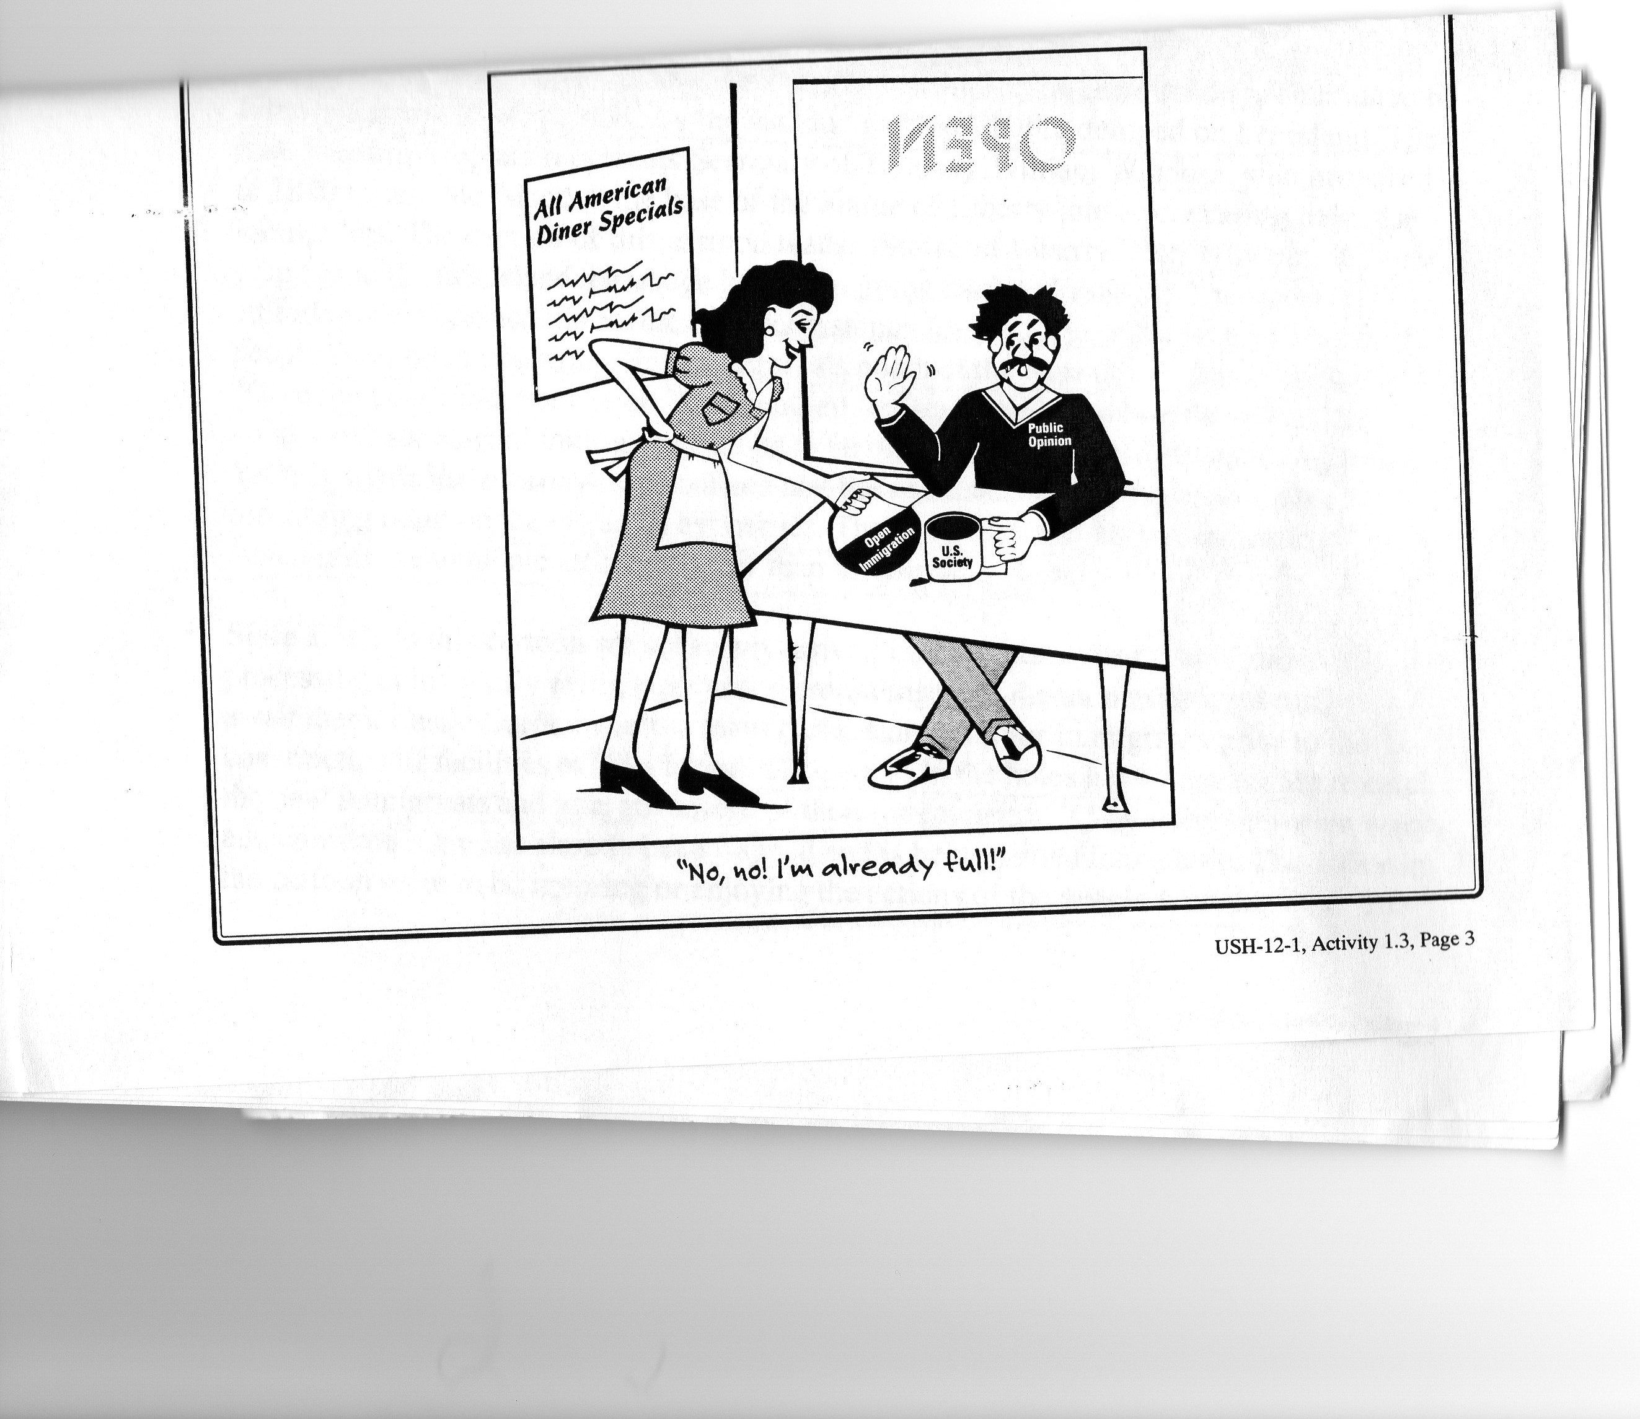

Slide 4
Are Illegal Immigrants Good for the Economy? Right Side
YES | NO

