Slide 1
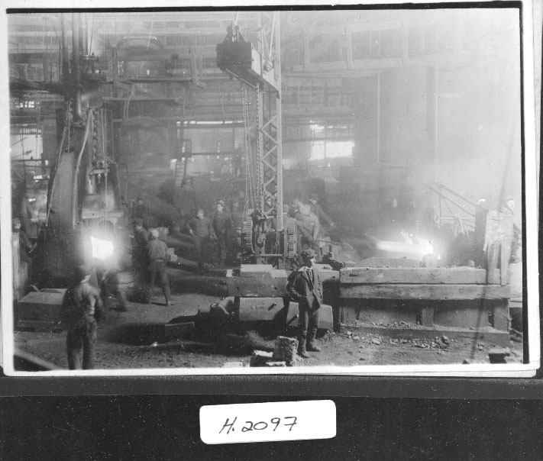

Slide 2
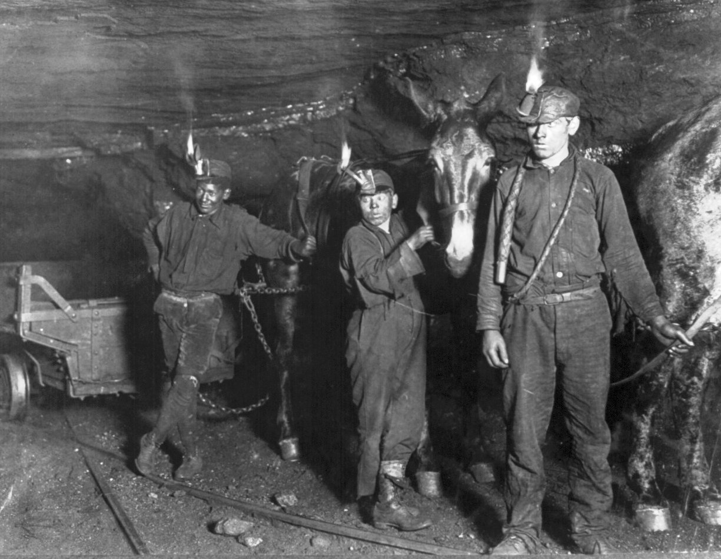

Slide 3
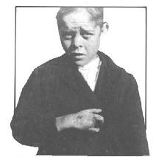

Slide 4
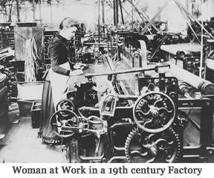

Slide 5
Notebook Entry #7 Left Side: Triangle Shirtwaist Factory Video Clip
Record the following questions with space to write in your answers as you watch the video:
Why was the fire at the Triangle Factory so bad?
How could it have been prevented?
Why were the owners acquitted (not guilty)?
What were some positive effects for the tragedy (i.e. new laws)?

