Slide 1
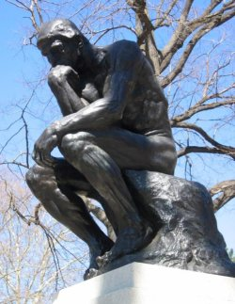
Enlightenment Historical Thinkers – Quiz with Answers

Slide 2
1. “If men are not naturally in a state of war, why do they always carry arms and why do they have keys to lock their doors?”
Wrote Leviathan

Slide 3
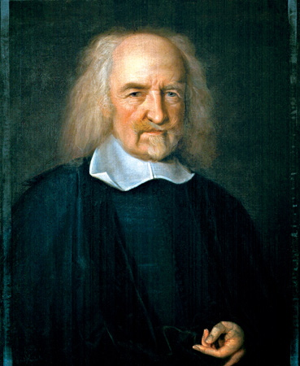
Thomas Hobbes

Slide 4
2.“I am the state (government)”
He came to be called the “Sun King” because it seemed his power and influence radiated from Versailles out to the entire world.

Slide 5
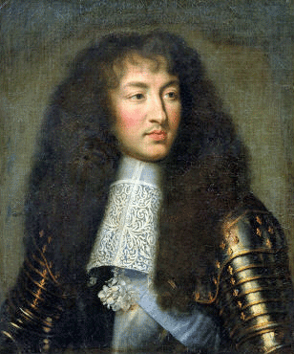
King Louis XIV

Slide 6
3. “Society will not be whole until the last king is strangled with the guts of the last priest”
Vindication of the Rights of Women

Slide 7
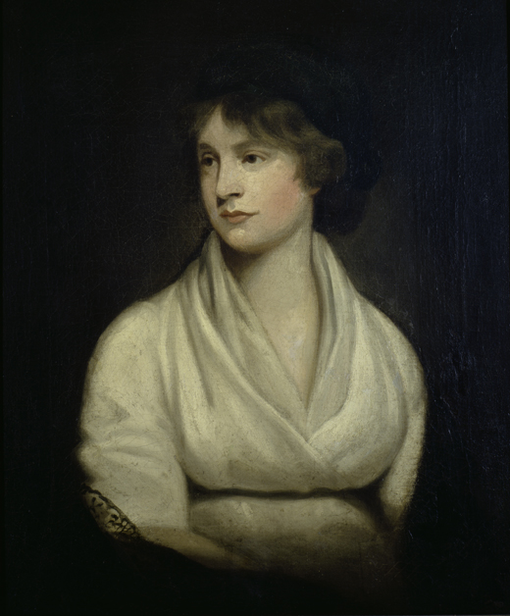
Mary Wollstonecraft

Slide 8
4. “When the (Lawmaking) and Law-enforcing powers are united in the same person…there can be no liberty.”
Persian Letters
On the Spirit of the Laws

Slide 9
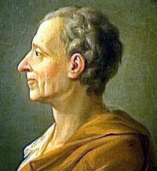
Baron de Montesquieu

Slide 10
5. “Whenever (the preservation of life, liberty, and property for which power is given to rulers by a commonwealth) is manifestly neglected or opposed, the trust must necessarily be forfeited and then(returned) into the hands of those that gave, who may place it anew where they think best for their safety and security.” Two Treatises of Government

Slide 11
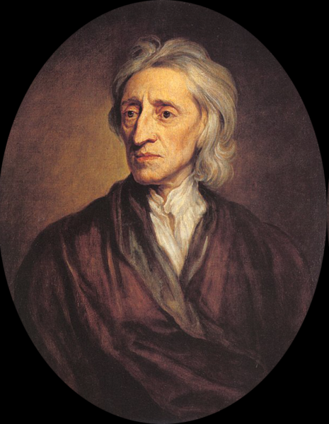
John Locke

Slide 12
6. “Man was born free, and everywhere he is in chains.”
The Social Contract

Slide 13
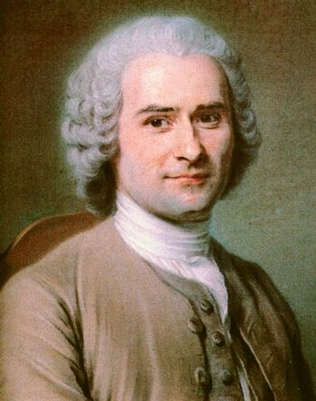
Jean-Jacques Rousseau

Slide 14
7. “(It is ) not merely unnecessary for a king to be a philosopher, but even a disadvantage. Rather a king should take advantage of true philosophers. Then he would fill his reign with good deeds, not with good words.”
Politics
On Kingship

Slide 15
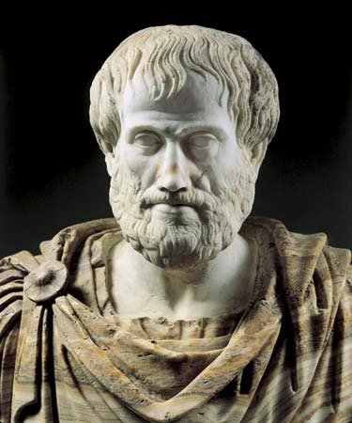
Aristotle

Slide 16
8.“For above all earthly treasure I esteem my people's love …I shall be judged by a (God)… to whose Judgment..I do appeal that never a thought was cherished in my heart that tended not to my people’s good.

Slide 17
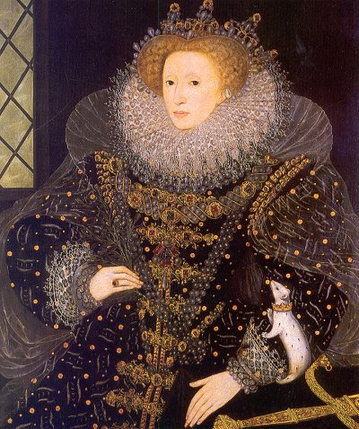
Queen Elizabeth I

Slide 18
9.“unless philosophers are kings, or those now kings and chiefs genuinely philosophize… there is no rest from ills for cities …nor, I think for human kind.”
Republic

Slide 19
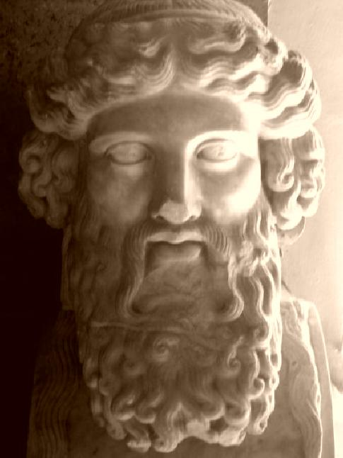
Plato

