Slide 1
The Vietnam War
Getting in…
1964-1975
Right Side of Notebook

Slide 2
Some Vietnam Facts
America’s second longest military conflict (Afghanistan has taken over as the longest)
Costly
57,000 Americans killed
4 million Vietnamese killed (10 percent of the population)
$120 billion in costs

Slide 3
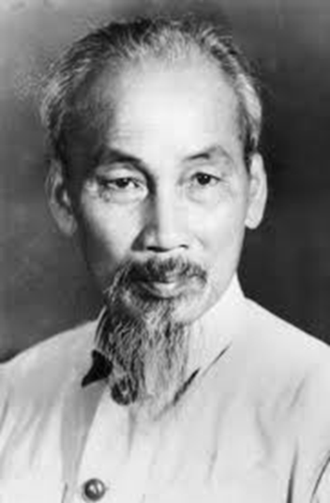
How did this start?
1886: France imperializes Vietnam, Cambodia,
and Laos
1941: While France is busy with WWII, Ho Chi Minh sets up the Vietnam Independence League (Viet Minh) to overthrow French rule
Declare independence in 1945, begins a war with France
U.S. backs France, giving $3 billion and supporting a French backed leader, Bao Dai
Soviet Union and China back Ho Chi Minh, a communist
1954: Viet Minh defeat France at the Battle of Dien Bien Phu

Slide 4
Critical Thinking – Left side
Look back at your map of the world and shade in Russia (Soviet Union), China and Vietnam.
Based on the map, why do you think the US started to get involved in Vietnam?
Why would the US have supported the French efforts to restore their power in Vietnam?
Think back to the Cold War…what was America fighting against?

Slide 5
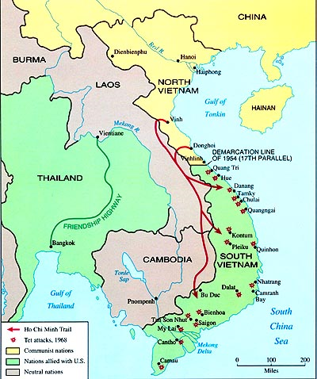
The Geneva Accords
France leaves Vietnam
Country divided “temporarily” into two parts
Ho Chi Minh in communist North Vietnam
Ngo Dinh Diem in U.S. backed South Vietnam
The magical reunification plan was to reunify in two years…
Surprise! This plan does not work! Hmmm, why would that be?

Slide 6
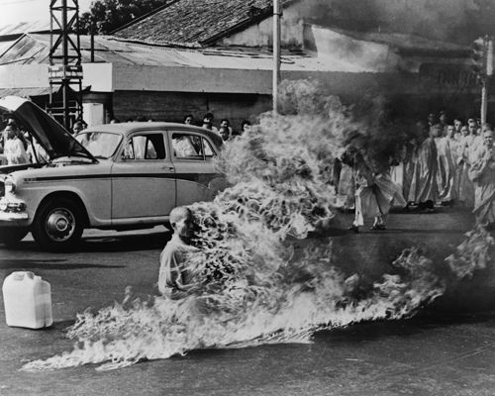
U.S. intervention
1953-1961: President Eisenhower backs anti-communist efforts in S. Vietnam
Domino Theory: if one country in Southeast Asia falls, they will all fall
JFK (1961-1963) supports Diem EVEN THOUGH he is anti-democratic and starts a policy of harassing and persecuting Buddhists
At least he’s not a communist?
JFK sends in military advisors (16,000 by 1963)
Rise of the Viet Cong (South Vietnamese who hate Diem)

Slide 7
U.S. presence escalates
Lyndon Johnson starts sending in more troops so he looks “tough on communism”
Gulf of Tonkin Incident:
U.S. sends in troops on fact finding missions in preparation of an attack on N. Vietnam
August 1964: A U.S. naval ship is attacked by communist patrol boats while on a mission in the Gulf of Tonkin; U.S. fires back aggressively
NVA boats no match for U.S. forces; Johnson justifies attack by arguing it was unprovoked
Gulf of Tonkin Resolution: After the incident, Congress gives LBJ the right to take “all necessary measures” to defend any nation in Southeast Asia from communist aggression
LBJ does not need a declaration of war to send in troops
By 1968, the height of the war, America will have over 500,000 troops stationed in Vietnam

Slide 8
Which Side???
South Vietnam and US
French
Ngo Dinh Diem
Army of the Republic of Vietnam (ARVN)
North Vietnam
Soviet Union
China
Ho Chi Minh
Viet Minh
North Vietnamese Army (NVA
Viet Cong (south Vietnamese who supported the north)

Slide 9
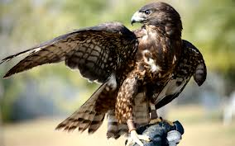
Process it! -Hawks vs Doves – Left Side
Hawks
Doves
Excerpt #
Short summary of the arguments the speaker uses to support his position…

Slide 10
Go Army! Brochure
The requirements: As the Public Relations officer for the United States Army, you have a big job ahead of you. Your brochure must include all of the following elements:
A slogan and a graphic on the cover
A brief explanation of why the United States is in Vietnam, focusing on what we are fighting against and why
At least three benefits of joining the military
At least two other graphics inside the brochure
Neat, well-written, and in color
10 points – staple finished product into notebook

Slide 11
Preparing to Debate the Merits of US Involvement in the War
1. Read Group’s Perspective (highlight key ideas)
2. Answer the Discussion Questions on the right Side of your notebook
3. Read and highlight the Primary Sources on group
4. Create and complete the spoke diagram on the Left Side of your notebook

Slide 12
What I
Feel
What I
Hear
What I
Experience
Vietnam
War
What I See
What I Want

